Slide 1

Banking Management System
Vyshnavi
Swathi
Tulasi
Sushmitha
Sudheshna

Slide 2

Contents
Introduction
ER-Diagram
Types of Users
Types of Accounts
Transactions
Transfer of Funds
Conclusion

Slide 3
Introduction
The Financial and Banking system had, and still have a great impact on the economic situation in the world.
Financial news is dominating the Headlines.

Slide 4
Banking is simply rotation of Funds and even means Saving & Exchange of money.
Present, Financial world is running
back to banking sector.

Slide 5
Use-Case Diagram
Open Account
Deposit
Withdraw
Customer
Clerk
Loan
Get_Reports
Manager
Cashier

Slide 6

Types of Users
Manager
Cashier
Clerk
Customer

Slide 7
Manager :
Maintain ongoing responsibility for all daily branch operations while actively developing existing and new customer relationships.
Play a key role in developing branch action plans in order to ensure continued branch growth.

Slide 8
Cashier :
They are the first people to connect with on getting into the banking hall. It is therefore their responsibility to portray the bank in good light and make the customer’s experience satisfactory.

Slide 9
Their duties covers assisting customers with daily cash inquiries which includes accepting credit slips, sorting of checks, and ensuring a balance in all transactions at the end of the working period.
Other tasks they perform are handling complaints and requests from customers and resolving the issues.

Slide 10
Clerk :
Behind the scenes in a bank , many people work to help keep things running smoothly. As a bank clerk, you would be one of these important people.

Slide 11
Careful records must be kept for every action carried out within the bank, from a cheque being cashed to a loan being taken out.
Bank clerk means you're responsible for maintaining these records, depending on your specialist field.

Slide 12
Customer :
A customer is an individual or business that enjoy services produced by a Bank.
Attracting customers is the primary goal of most public-facing businesses, because it is the customer who creates demand for services.

Slide 13

Types of Accounts
Current Account
Savings Account
Fixed Account
Recurring Account
Loans

Slide 14
Current Account:
An account with a bank or building society from which money may be withdrawn without notice, typically an active account catering for frequent deposits and withdrawals by cheque.

Slide 15
Savings Account:
A savings account is an interest-bearing deposit account held at a bank or another financial institution that provides a modest interest rate.

Slide 16
Banks may limit the number of withdrawals you can make from your savings account each month, and they may charge fees unless you maintain a certain average monthly balance in
account.

Slide 17
Fixed Account:
It is a financial instrument provided by banks which provides investors with a higher rate of interest than a regular savings account, until the given maturity date. It may or may not require the creation of a separate account.

Slide 18
Recurring Account:
It is a special kind of Term Deposit offered by banks in India which help people with regular incomes to deposit a fixed amount every month into their Recurring Deposit account and earn interest at the rate applicable to Fixed Deposits.

Slide 19
Loans:
A bank loan is a fixed amount for a fixed term with regular fixed repayments. The interest on a loan tends to be lower than an overdraft.

Slide 20
Transactions:
A transaction is a business event that has a monetary impact on an entity's financial statements, and is recorded as an entry in its accounting records.

Slide 21
Transfer of Funds:
Electronic funds transfer (EFT) is the electronic transfer of money from one bank account to another, either within a single financial institution or across multiple institutions, via computer-based systems, without the direct intervention of bank staff.

Slide 22
Data-Base:
A structured set of data held in a computer, especially one that is accessible in various ways.
The data is stored in the form of tables.

Slide 23
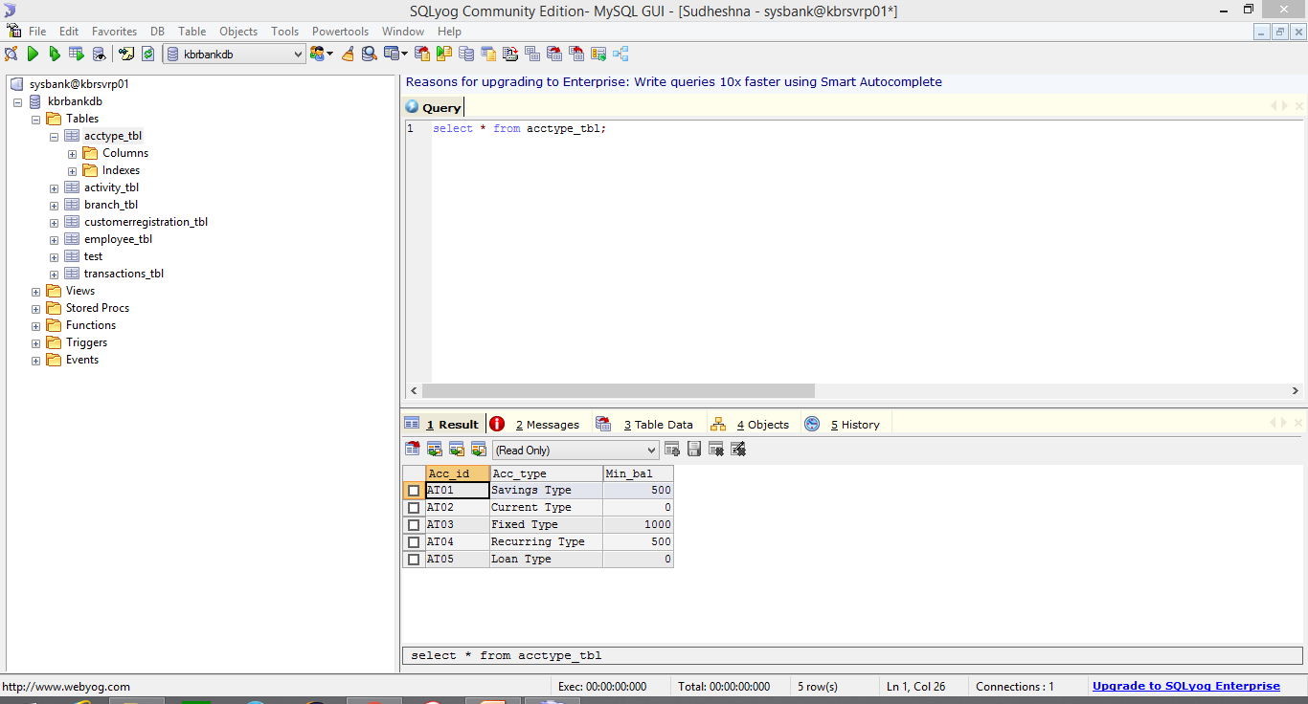

Slide 24
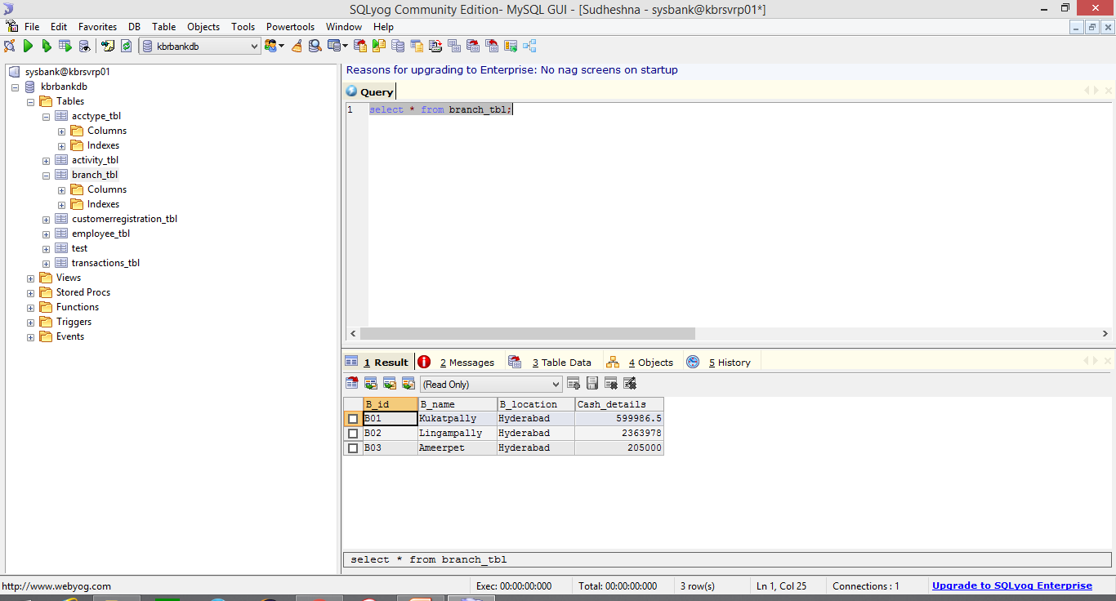

Slide 25
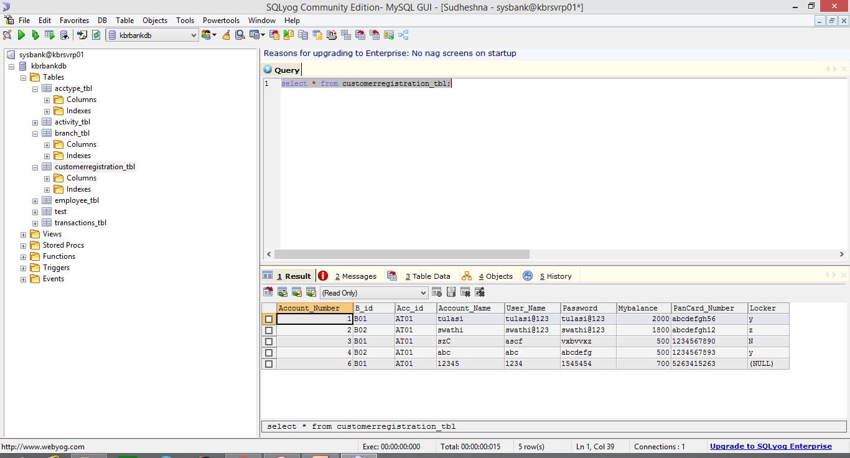

Slide 26
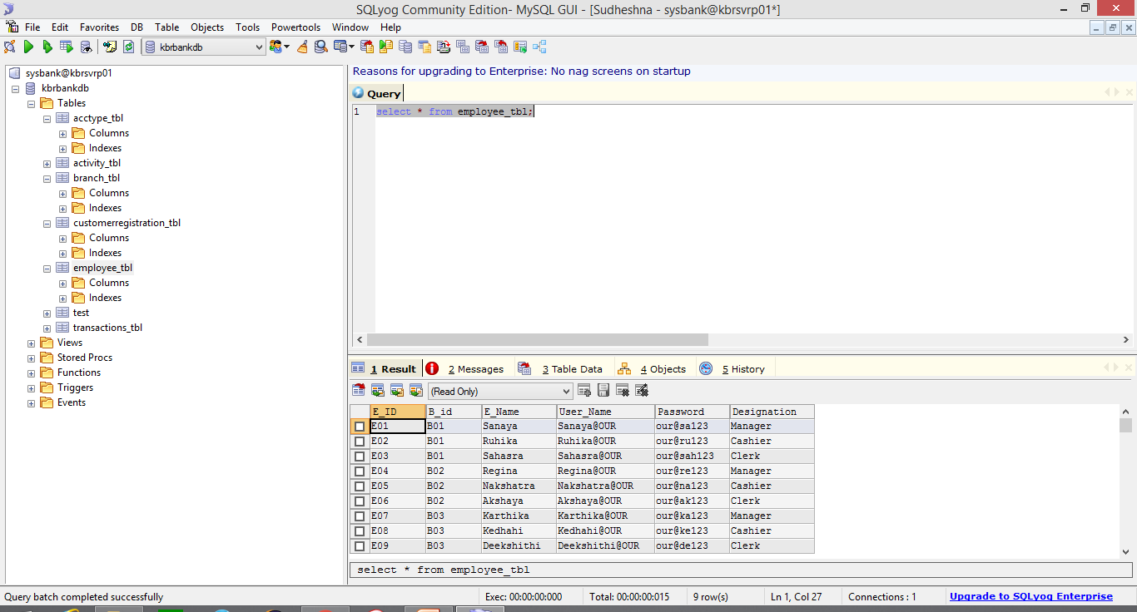

Slide 27
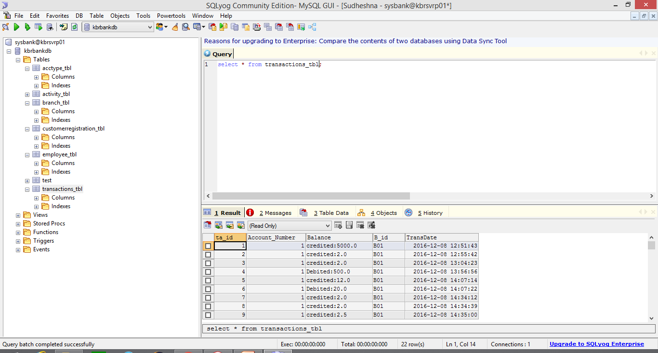

Slide 28
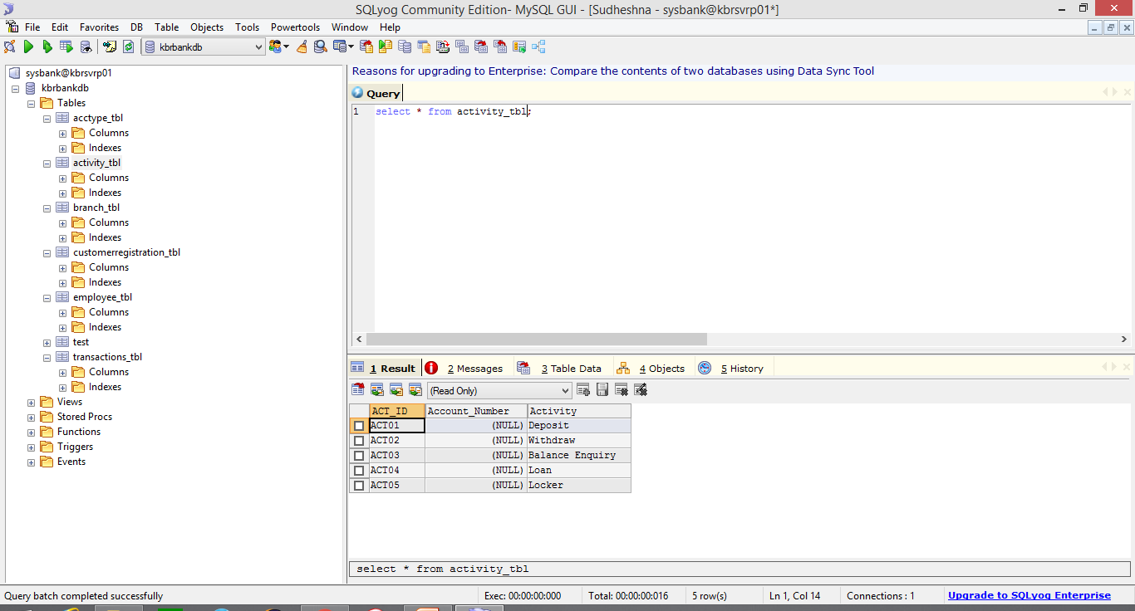

Slide 29
Authentication and Authorization:
Authorization is the process of verifying that you have access to something. Gaining access to a resource ,because the permissions configured on it allow you access is authorization.

Slide 30

Any Other Clarification till the point

